Slide 1

CSE4037
REINFORCEMENT LEARNING
A PARTIALLY OBSERVABLE MARKOV DECISION PROCESS

Slide 2
Module No. 6
Hierarchical Reinforcement Learning
8 Hours
Hierarchical Reinforcement Learning
Types of Optimality
Semi MDP Model
Options
Learning with Options
Hierarchical Abstract Machines
A partially observable Markov decision process

Slide 3
A Partially Observable Markov Decision Process (POMDP)
Partially Observable Markov Decision Processes (POMDP) is a mathematical framework to model sequential decision-making processes with the constraint that the decision maker has incomplete information about the environment.
This is useful in various domains like Artificial Intelligence, Reinforcement Learning, robotics, game theory, and many others.

Slide 4
A Partially Observable Markov Decision Process (POMDP)
In Artificial Intelligence, an agent/decision-maker needs to go through various decision-making processes to take appropriate actions in an environment to maximize the gain of rewards.
Partially Observable Markov Decision Process (POMDP) is a mathematical framework to model sequential decision-making processes in real-life scenarios wherein the decision-maker does not have complete information about the environment in which it works.
Therefore, POMDP finds its applications in various domains like AI, operations research, economics, robotics, and many others. We formally define POMDP in the next section.

Slide 5
What are POMDPs?
A POMDP can be represented by the tuple (𝑆,𝐴,𝑇,𝑅,Ω,𝑂,𝛾) where,
𝑆: refers to the set of states in the environment.
𝐴: denotes the set of possible actions taken by the decision maker.
𝑇: refers to a conditional transition probability distribution of the next state when the current state and chosen action are given.
𝑅: is a function that takes state and action as input and provides the corresponding reward as output.
Ω: refers to the set of possible observations made by the decision-maker.
𝑂: is a conditional probability distribution of the observations when the current state and chosen action are given.
𝛾: represents the discount factor used to compute the expected sum of discounted future rewards.

Slide 6
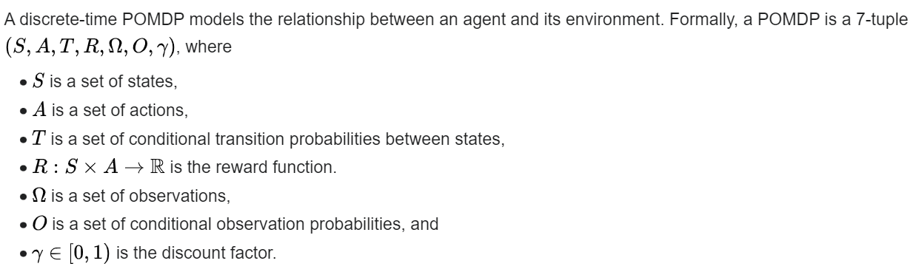
Formal definition

Slide 7
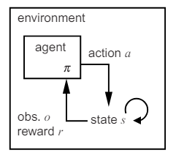
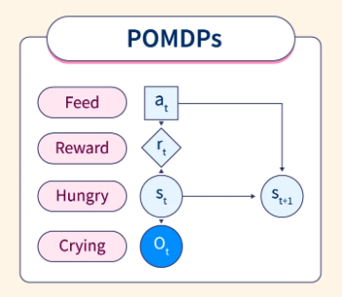
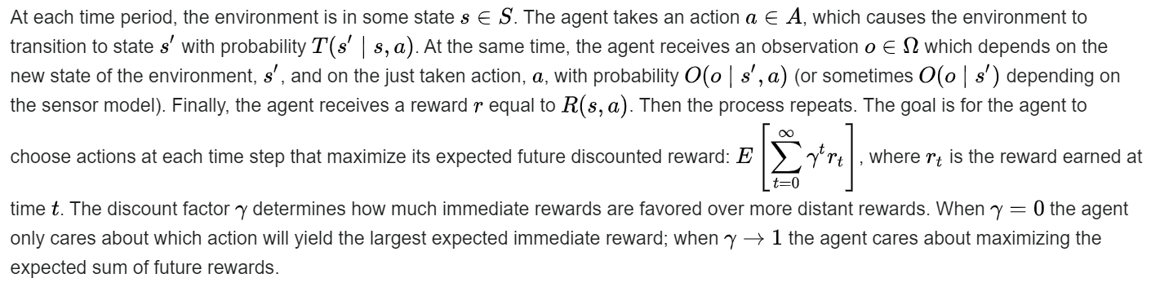

Slide 8
What are POMDPs?
The agent does not directly observe the environment's state, the agent must make decisions under uncertainty of the true environment state. However, by interacting with the environment and receiving observations, the agent may update its belief in the true state by updating the probability distribution of the current state.
A consequence of this property is that the optimal behavior may often include (information gathering) actions that are taken purely because they improve the agent's estimate of the current state, thereby allowing it to make better decisions in the future.

Slide 9
What are POMDPs?
It is instructive to compare the above definition with the definition of a Markov decision process.
MDP does not include the observation set, because the agent always knows with certainty the environment's current state.
Alternatively, an MDP can be reformulated as a POMDP by setting the observation set to be equal to the set of states and defining the observation conditional probabilities to deterministically select the observation that corresponds to the true state.

Slide 10
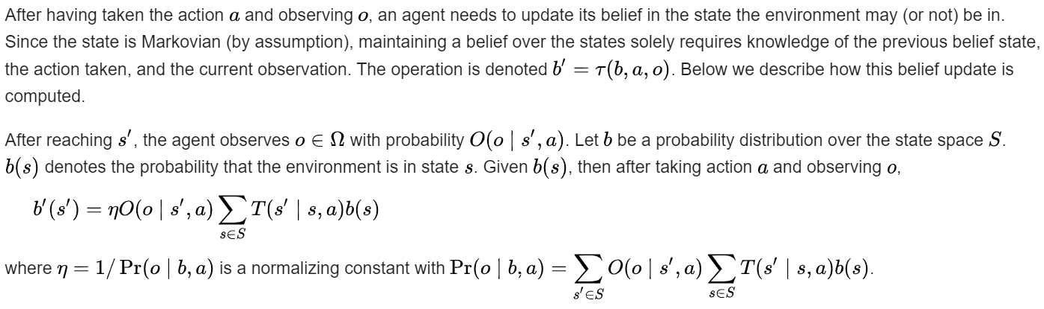
Belief update

Slide 11
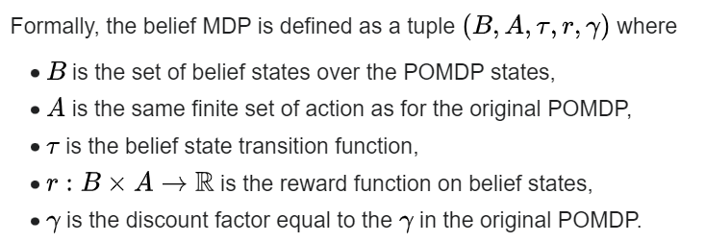
Belief MDP
A Markovian belief state allows a POMDP to be formulated as a Markov decision process where every belief is a state. The resulting belief MDP will thus be defined on a continuous state space (even if the "originating" POMDP has a finite number of states: there are infinite belief states (in 𝐵) because there are an infinite number of probability distributions over the states (of 𝑆)

Slide 12
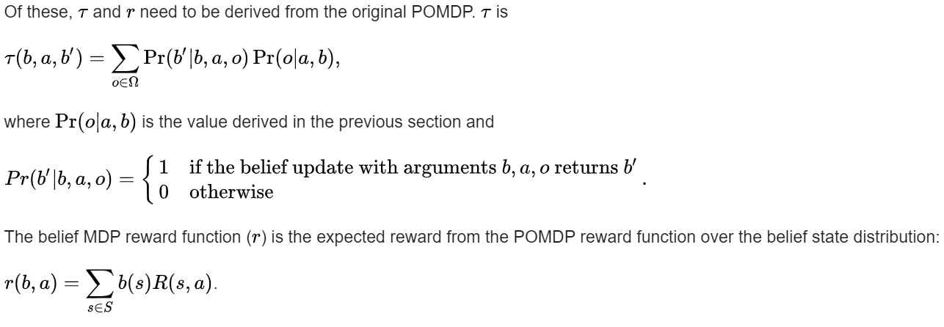
The belief MDP is not partially observable anymore, since at any given time the agent knows its belief, and by extension the state of the belief MDP

Slide 13
Approximate POMDP solutions
In practice, POMDPs are often computationally intractable to solve exactly. This intractability is often due to the curse of dimensionality or the curse of history (the fact that optimal policies may depend on the entire history of actions and observations).
To address these issues, computer scientists have developed methods that approximate solutions for POMDPs. These solutions typically attempt to approximate the problem or solution with a limited number of parameters, plan only over a small part of the belief space online, or summarize the action-observation history compactly.

Slide 14
Approximate POMDP solutions
Grid-based algorithms comprise one approximate solution technique.
In this approach, the value function is computed for a set of points in the belief space, and interpolation is used to determine the optimal action to take for other belief states that are encountered which are not in the set of grid points.
More recent work makes use of sampling techniques, generalization techniques and exploitation of problem structure, and has extended POMDP solving into large domains with millions of states.
For example, adaptive grids and point-based methods sample random reachable belief points to constrain the planning to relevant areas in the belief space. Dimensionality reduction using PCA has also been explored.

Slide 15
Approximate POMDP solutions
Online planning algorithms approach large POMDPs by constructing a new policy for the current belief each time a new observation is received.
Such a policy only needs to consider future beliefs reachable from the current belief, which is often only a very small part of the full belief space. This family includes variants of Monte Carlo tree search and heuristic search. Similar to MDPs, it is possible to construct online algorithms that find arbitrarily near-optimal policies and have no direct computational complexity dependence on the size of the state and observation spaces.

Slide 16
Approximate POMDP solutions
Another line of approximate solution techniques for solving POMDPs relies on using (a subset of) the history of previous observations, actions and rewards up to the current time step as a pseudo-state. Usual techniques for solving MDPs based on these pseudo-states can then be used (e.g. Q-learning).
Ideally the pseudo-states should contain the most important information from the whole history (to reduce bias) while being as compressed as possible (to reduce overfitting).

Slide 17
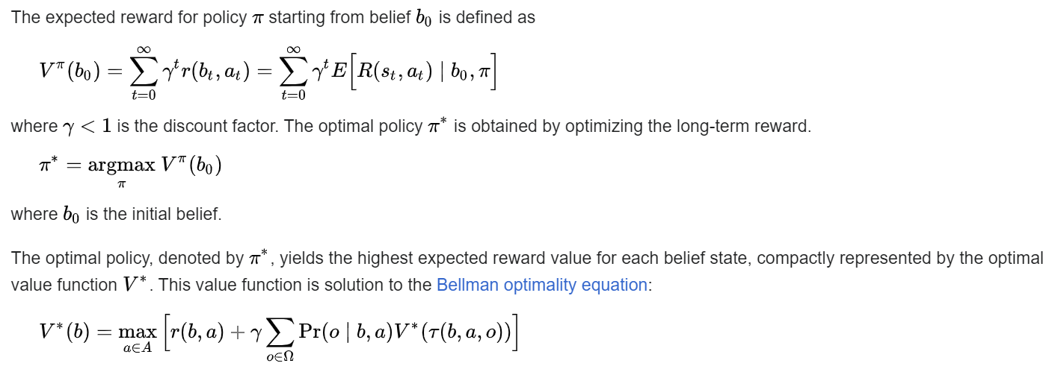
Policy and value function

Slide 18
Summary
An exact solution to a POMDP yields the optimal action for each possible belief over the world states.
The optimal action maximizes the expected reward (or minimizes the cost) of the agent over a possibly infinite horizon. The sequence of optimal actions is known as the optimal policy of the agent for interacting with its environment.

Slide 19
Applications
POMDPs can be used to model many kinds of real-world problems.
Notable applications include the use of a POMDP in management of patients with ischemic heart disease, assistive technology for persons with dementia (Alzheimer's disease), the conservation of the critically endangered and difficult to detect Sumatran tigers and aircraft collision avoidance.
One application is a teaching case, a crying baby problem, where a parent needs to sequentially decide whether to feed the baby based on the observation of whether the baby is crying or not, which is an imperfect representation of the actual baby's state of hunger.

